Slide 1
Word Wealth Unit 5
Entry and Related Words
Words 1-10 Verbs
Words 11-20 Nouns

Slide 2
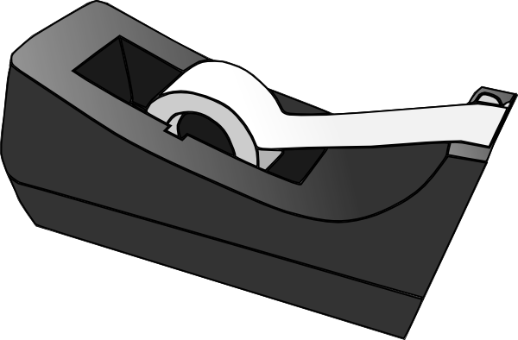
1. Adhere
To stick fast, cling

Slide 3
2. Alter
To change or modify
RW: alter ego (“other self”)
RW: deviate (to turn from an intended plan or course of action)

Slide 4
3. Assail
To attack (assail my students for failing to turn in papers)
RW: Assault (a violent, often bodily, attack)

Slide 5
4. Augment
To increase, make, or become larger
RW: enhance (increase in attractiveness or value)
RW: aggravate (increase in seriousness of an illness or problem)

Slide 6
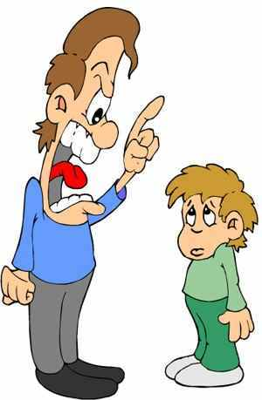
5. Chastise
To punish

Slide 7
6. Disperse
To scatter, separate

Slide 8
7. Diverge
To branch off, go in different directions

Slide 9
8. Emulate
To strive to equal or excel
RW: vie (suggests rivalry-potential employees vie with one another for a position)
Who do you emulate?

Slide 10
9. Extricate
To disentangle

Slide 11
10. Forage
To search for, ravage, plunder
RW: pillage (to take food, money, property by force)
“We’ve got a village to pillage!”

Slide 12
1. Antagonist
A rival, opponent, adversary
Who are some antagonists you have met in literature and film?

Slide 13
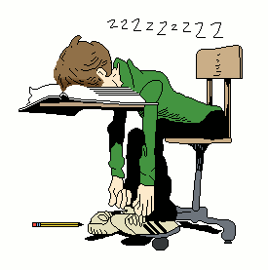
2. Apathy
Lack of feeling, indifference
RW: lethargy (drowsiness or sluggishness)
RW: stupor (deadened state of mind from drugs or shock)

Slide 14
3. Avarice
Greed for money
RW: covetous (to desire something too strongly)
“Thou shall not covet..”

Slide 15
4. Clarity
Clearness
RW: elucidate (to make clear)

Slide 16
5. Conjecture
A guess, inference
RW: hypothesis (a plausible theory or explanation)
RW: speculation (imaginative guess)
RW: Thesis (statement you will prove)
RW: assumption (an accepted guess or belief based on a truth)-innocent until proven guilty.

Slide 17
6. Defiance
Bold opposition, open challenge

Slide 18
7. Dexterity
Skill, adroitness (mental skill)

Slide 19
8. Discretion
Prudence, wise restraint
RW Synonym: prudence (caution mixed with wisdom)
WARNING: Due to the content of this program, viewer discretion is advised!

Slide 20
9. Exertion
Vigorous effort
RW: endeavor (sustained but less vigorous)

Slide 21
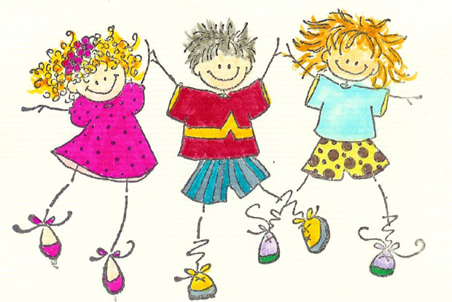
10. Exuberance
Overflowing spirits, zestfulness
RW: elation (a quieter kind of high spirits over success or good news)

